Slide 1

Environmental sound classification using deep learning
Manoj Kolpe Lingappa

Slide 2
Introduction
Main goal of the approach is to classify the non stationary environmental sound.
A state of the art neural network architecture is proposed to achieve a good accuracy in classification.
This method is based on analyzing the characteristics of the audio signal and feeding the signal to the neural network for classification.
Features are extracted from the spectrogram of audio signal and classified using the probability theory concept.
Architecture is tested on stationary dataset and results are compared with the non stationary dataset.
The behaviour of the architecture on different type of audio sound is studied.
Environmental sound classification using deep learning - Manoj

Slide 3
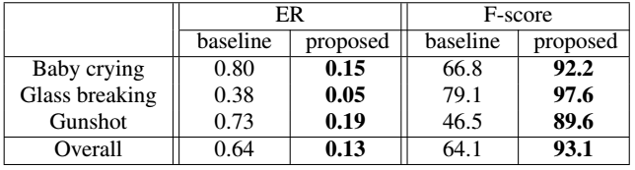
Existing model and their performance
RARE SOUND EVENT DETECTION USING 1D using CRNN [1]:
Proposed framework in [1] is shown in the figure 1 below.
The framework consist of four major steps: 1) log-amplitude mel-spectrogram extracted from audio 2) Spectral features are extracted with 1D ConvNet 3) RNN-LSTM is used to find the temporal dependency. 4) sound event detection and the onset time of audio.
Dataset used for evaluation: TUT Rare Sound Events 2017, The dataset consist of three classes with background noise, ‘baby crying’, ‘glass breaking’, and ‘gunshot’.
Result: Baseline: DCASE 2017 baseline system, ER-error rate. Ensemble is used to find overall effect.
Performance of baseline and proposed system in the evaluation set.
Environmental sound classification using deep learning - Manoj

Slide 4
Existing model and their performance
Environment Sound Classification Using a Two-Stream CNN Based on Decision-Level Fusion [2]:
Combined features (Figure 2) are extracted from the sound and this features is fed into four four-layer(Two branches, each having four layers of CNN) CNN (Figure 3).
Two branches output is fused using the Dempster–Shafer evidence theory (Figure 4) to compose TSCNN-DS model and prediction is made.
Steps involved: 1) Feature Extraction and Combination (Figure 2) 2) Structure of the MCNet and LMCNet 3)Dempster—Shafer Evidence Theory-Based Information Fusion (Figure 4).
Dataset used for evaluation: UrbanSound8K dataset (8732 labeled urban sounds, the length is less than or equal to 4s), air conditioner (ac), car horn (ch), children playing (cp), dog bark (db), drilling (dr), engine idling (ei), gunshot (gs), jackhammer (jh), siren (si) and street music (sm).
The classification accuracy of CNN-based ISR system is nearly equal to 97% in ESC tasks.
Environmental sound classification using deep learning - Manoj

Slide 5
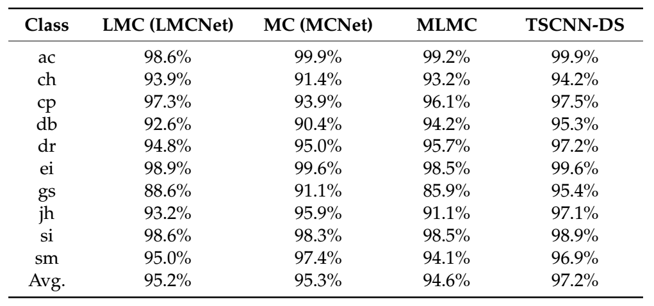
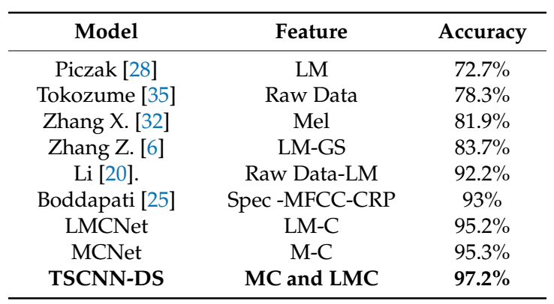
Results
Courtesy:Environment Sound Classification Using a Two-Stream CNN Based on Decision-Level Fusion. Yu Su 1,2,* , Ke Zhang 1, Jingyu Wang 1 and Kurosh Madani 2
Table 1. Class-wise accuracy of four models with four-layer CNN evaluated on UrbanSound8K
Table2. Comparison of classification accuracy with other models on UrbanSound8K datasets.
Environmental sound classification using deep learning - Manoj

Slide 6
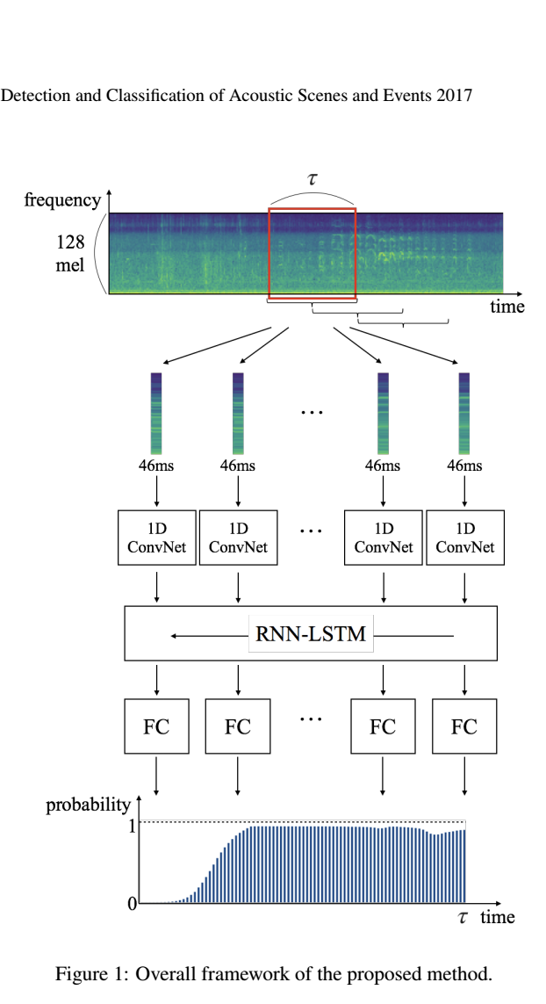
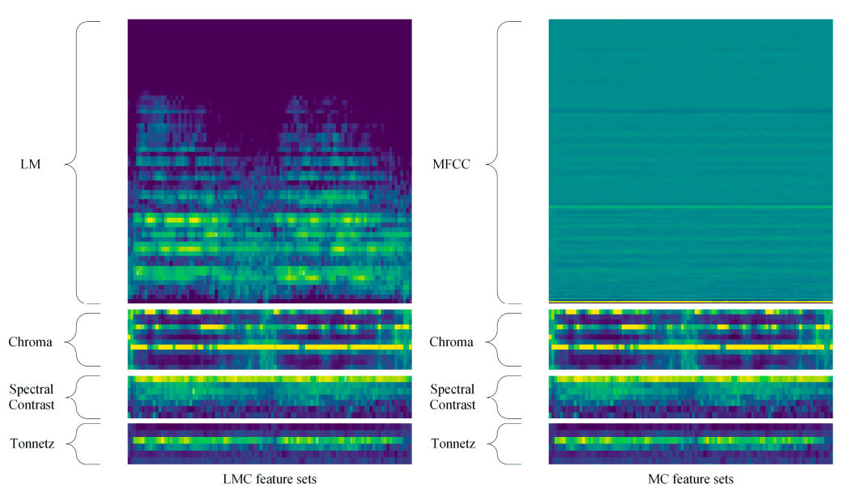
Courtesy: RARE SOUND EVENT DETECTION USING 1D CONVOLUTIONAL RECURRENT NEURAL
NETWORKS Hyungui Lim1, Jeongsoo Park1;2, Kyogu Lee2, Yoonchang Han1
Courtesy:Environment Sound Classification Using a Two-Stream CNN Based on Decision-Level Fusion
Yu Su 1,2,* , Ke Zhang 1, Jingyu Wang 1 and Kurosh Madani 2
Figure 2: The spectrogram of LMC and MC feature sets
Figure 1: Overall framework of the proposed method

Slide 7
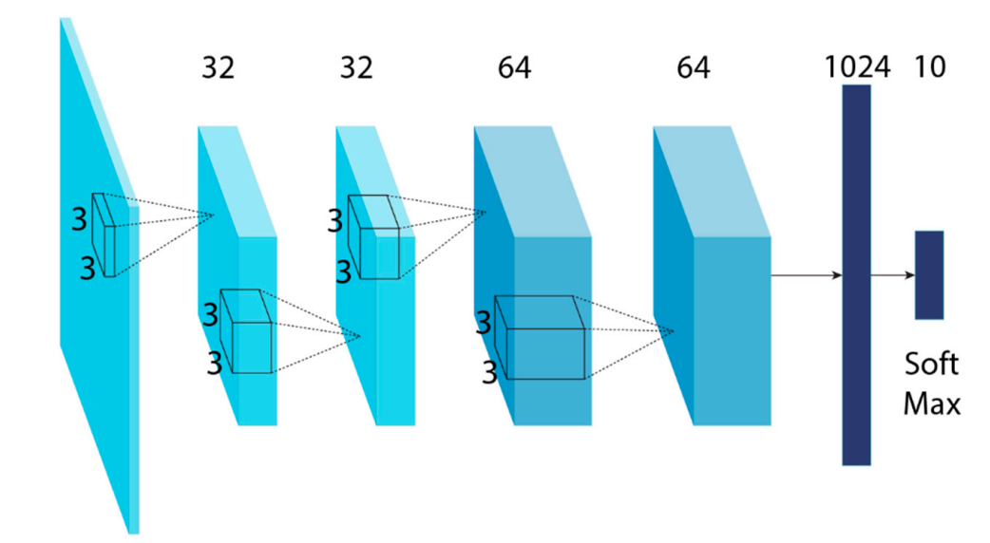
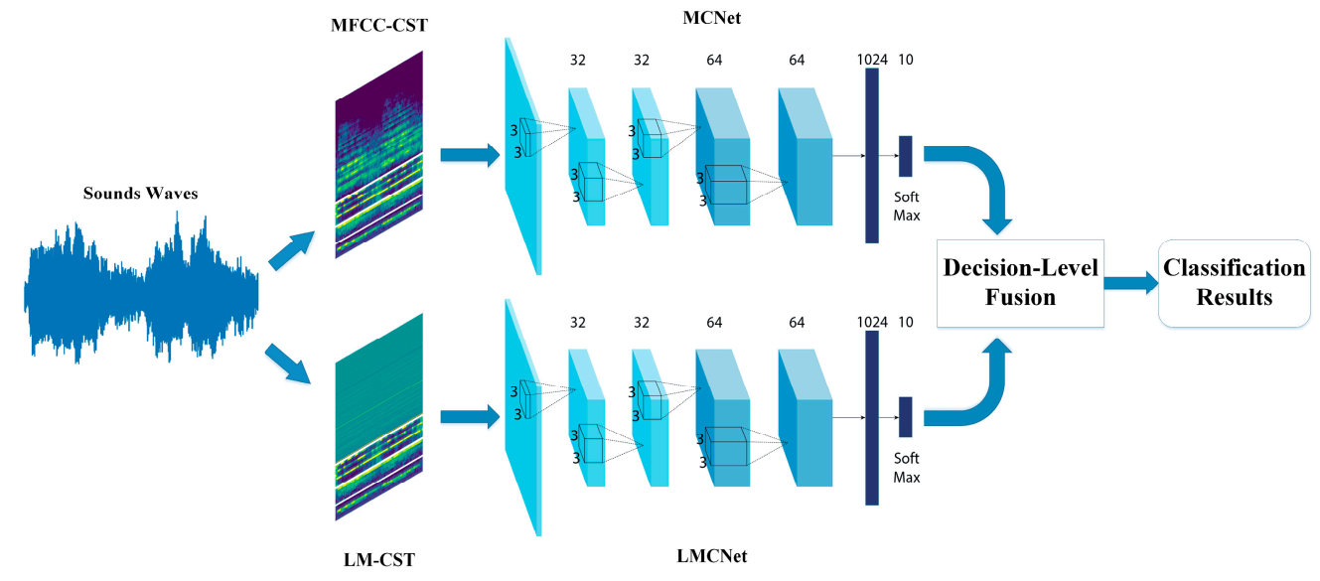
Figure 3: The architecture of the four-layer CNN
Courtesy:Environment Sound Classification Using a Two-Stream CNN Based on Decision-Level Fusion. Yu Su 1,2,* , Ke Zhang 1, Jingyu Wang 1 and Kurosh Madani 2
Figure 4: The overall framework

Slide 8
Proposed architecture
Environmental sound is a non stationary sound.
According to [3], temporal and spectral characteristics of the sound needs to be considered during processing of the signal to make a classification
Representing the sound signal with temporal and spectral characteristics maximize the information content pertaining to sound signal.
The proposed model in [2] has achieved good accuracy rate compared to the other models.
However the model doesn’t incorporate the temporal dependency of the extracted features.
The proposed model (Figure 5) takes into consideration both temporal and spectral characteristics.
1) Combined features are extracted from the sound
2) The features is fed into four four-layer(Two branches, each having four layers of CNN) to extract the spectral features.
3) RNN-LSTM is used to find the temporal dependency.
4) Two branches output is fused using the Dempster–Shafer evidence theory.
Environmental sound classification using deep learning - Manoj

Slide 9
Courtesy:Environment Sound Classification Using a Two-Stream CNN Based on Decision-Level Fusion. Yu Su 1,2,* , Ke Zhang 1, Jingyu Wang 1 and Kurosh Madani 2
Figure 5: The proposed overall framework
Environmental sound classification using deep learning - Manoj

Slide 10
Dataset
Urbansound8k [4]:
This dataset contains 8732 labeled sound of 4 sec length in WAV format.
10 classes were defined: air_conditioner, car_horn, children_playing, dog_bark, drilling, enginge_idling, gun_shot, jackhammer, siren, and street_music.
Nearly 870 slices of data per class.
DCASE 2018, Monitoring of domestic activities based on multi-channel acoustics - Evaluation dataset [5](Benchmarking available):
Total of 72984, 10 sec audio dataset.
The continuous recordings in home environment were split into audio segments of 10s.
9 classes were considered, format[activity,# 10s segment,#sessions]: [Absence (nobody present in the room),18860,42],[Cooking,5124,13],[Dishwashing,1424,10],[Eating,2308,13],[Other (present but not doing any relevant activity),2060,118],[Social activity (visit, phone call),4944,21],[Vacuum cleaning,972,9],[Watching TV,18648,9],[Working(typing,mouse click..etc),18644,33]
Environmental sound classification using deep learning - Manoj

Slide 11
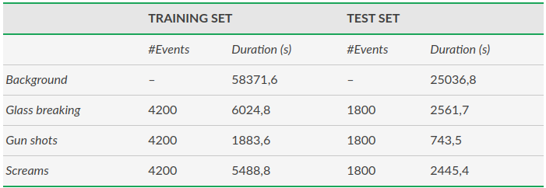
Dataset
Audio Events Data Set for Surveillance Applications [6]
The MIVIA audio events data set is composed of a total of 6000 events for surveillance applications, namely glass breaking, gun shots and screams in WAV format.
Environmental sound classification using deep learning - Manoj

Slide 12
Dataset
TUT Rare sound events, Evaluation dataset [7]:
classes baby cry, gun shot, glass break with background audio
Environmental sound classification using deep learning - Manoj

Slide 13
Data augmentation
Noise Injection
Shifting Time
Changing Pitch
Changing Speed
Environmental sound classification using deep learning - Manoj

Slide 14
Extra work
Test the architecture with different kind of sounds and study the behaviour of the model.
Try to generalize the model for different types of sound.
Environmental sound classification using deep learning - Manoj

Slide 15
Reference
Lim, Hyungui, Jeongsoo Park, and Yoonchang Han. "Rare sound event detection using 1D convolutional recurrent neural networks." Proceedings of the Detection and Classification of Acoustic Scenes and Events 2017 Workshop. 2017.
Su, Y., Zhang, K., Wang, J., & Madani, K. (2019). Environment sound classification using a two-stream CNN based on decision-level fusion. Sensors, 19(7), 1733.
Environmental sound recognition: a survey. sachin chachada and c.-c. jay kuo
https://urbansounddataset.weebly.com/urbansound8k.html
http://dcase.community/challenge2018/task-monitoring-domestic-activities
https://mivia.unisa.it/datasets/audio-analysis/mivia-audio-events/
https://zenodo.org/record/1160455#.W9muM1Vfi7A
Environmental sound classification using deep learning - Manoj

